Slide 1
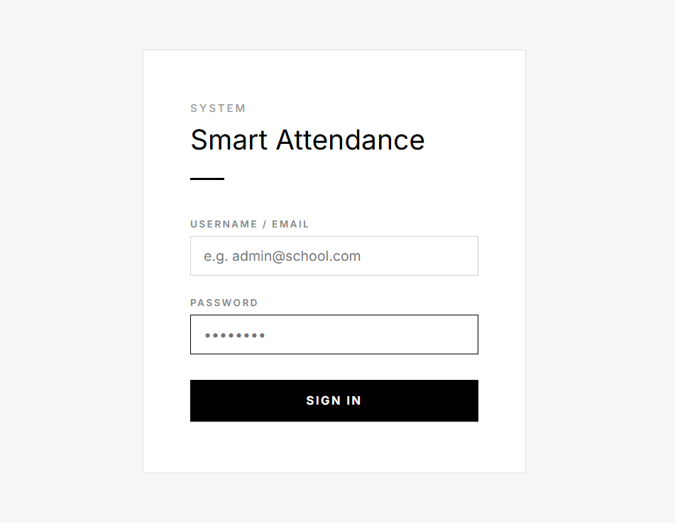


Personalized Retail Recommendation AI Agent
Presented by:
SHRAVAN TALEKI
© Indium

Slide 2



AGENDA
PROBLEM STATEMENT
SOLUTION & TECH STACK
ARCHITECTURE DIAGRAM
KEY FEATURES
© Indium
‹#›

Slide 3
PROLEM STATEMENT
Generic AI retail agents often prioritize "chat" over "accuracy," leading to a breakdown in shopper trust and data security.
Data Hallucinations: Recommending out-of-budget, non-existent, or "ghost" products.
Privacy Compromise: Cloud dependency risks sensitive shopper PII and proprietary catalog data.
Latency Barriers: High-SLA cloud models result in slow responses, breaking the shopping flow.
Aesthetic Gap: Standard AI UIs lack the premium feel required for luxury e-commerce.
Disconnected Logic: Failure to pair logical follow-ups (e.g., matching shoes with a dress).
© Indium
‹#›

Slide 4





SOLUTION:
100% Offline Ecosystem: Absolute privacy and zero data leakage using local inference via Ollama.
Hybrid Reliability: Rule-based Pandas filtering ensures 0% product hallucinations and 100% budget compliance.
High Performance: Sub-5-second response times achieved via the ultra-fast Qwen 1.5B model.
Luxury User Experience: Streamlit-powered dashboard with interactive, zero-scroll grid layouts and mobile-responsive CSS.
Contextual Intelligence: Multi-factor reasoning considering local trends, social influence, and upcoming events.
© Indium
‹#›

Slide 5
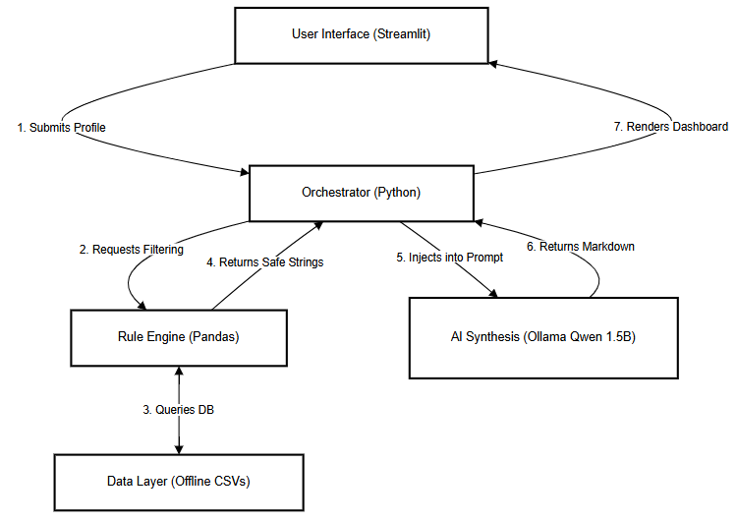
ARCHITECTURE DESIGN
© Indium
‹#›

Slide 6












KEY FEATURES
🖥️
FEATURE 01
✅
FEATURE 02
🖼️
FEATURE 03
Deterministic Filtering
Zero-Hallucination Formatting
Interactive Storefront
Strict budget and category enforcement using mathematical logic.
LLM reasoning restricted to candidate pools provided by tools.
A premium product card grid with instant "Add to Cart" engagement.
Pandas
Rules Engine
Prompt Engineering
Qwen 1.5B
Streamlit
Glassmorphism CSS
🗄️
FEATURE 04
💧
FEATURE 05
🌊
FEATURE 06
Context-Aware Foresight
Deterministic Fallbacks
100% Offline Privacy
AI-driven logic for planning "Next Likely Purchases" based on current intent.
Python-based formatting backups ensure the UI never breaks, even if the LLM fails.
Full data sovereignty with no external API calls or cloud dependencies.
Data Engineering
Cross-sell logic
Python
Fault Tolerance
Local Inference
Ollama
© Indium

Slide 7

THANK YOU

